Slide 1
Interacting with Applications

Slide 2
Agenda
Interaction with applications
Automation basics
Application Types
Selenium basics
Application Platforms
Notes:
There are different types of apps – web, hybrid & native which run on different platforms. In this module we’ll make sense of all the options and explain how to work with each app. In later modules we will go in-depth into the how-to of all we are presenting now.

Slide 3
Interacting with applications – why Automation
In the previous session we showed Perfecto’s basic support for Manual testing of applications on Perfecto Lab devices.
One disadvantage of manual testing is the inability to completely repeat the test.
Performing the steps exactly in the same order is problematic.
The timing of the interactions is never the same.
Automation addresses these problems
Prepare the full test process in a software platform.
Execute the test script repetitively – always the same process and timing.
May be executed by CI tools – like Jenkins.
Selenium and Appium are open source testing frameworks for automation, with support for standard programming languages.

Slide 4
Automation - basics
Automation tests require interacting with the application through software commands –
Clicking on buttons,
Entering text in text fields,
Selecting values,
etc.
All of these actions require that the automation “script” can identify the elements that appear on the applications UI.
There are 2 ways to perform this:
Using the programmed information of the Application Objects
Using Visual Analysis to perform the actions on the screen
Both Object manipulation and Visual analysis are supported by Perfecto
Notes:
Objects are recommended as the best practice
Visual is strongly dependent on screen size and resolution, should be used mainly for validation, or when objects are not possible

Slide 5
Object Interaction
The input for this method is the XML/HTML provided by the application.
We identify the object we want and then select the desired action:
Click
Text Entry
Swipe
Etc.
Object interaction is fast, reliable, & robust.
Objects are identified by an XPath or similar specification.
Stay tuned for the XPath unit.

Slide 6
Visual Interaction
Visual Analysis uses a screenshot taken from the device.
The screenshot is analyzed
Using an OCR engine for finding text
Using a bitmap comparison engine for images.
This method works directly on what the user sees but is slower & less reliable.
Slower – takes time to analyze the screenshot image.
Less reliable – cannot guarantee 100% match, usually settle for less.
It is valuable when used sparingly in the correct places in the test.
For example, when dismissing system popups or other dynamic objects.
Identifying image buttons.

Slide 7
Application Types
There are 3 types of applications in the market today:
Web applications – run on a mobile or desktop browser.
Can be tested on both mobile & desktop.
Objects are identified with an XPath expression – using DOM objects.
The Selenium driver is preferred tool to run automation tests.
Native Mobile Applications
Installed on a mobile device, (usually) from the app store.
Separate code base per platform.
Objects are identified with XPath (with iOS variations) specification
Appium driver is preferred tool to run automation tests

Slide 8
Application Types Continued
Hybrid Applications
Installed on a mobile device, from the app store
Characterized by a Web-based interface embedded in a Native application environment.
Native environment is separate code base per platform
Web-based interface is based on HTML specifications.
Objects are identified with XPath (with iOS variations) specification
May require switching to different object trees.
Appium driver is preferred tool to run automation tests

Slide 9
Automation Drivers
Automation “scripts” connect to the device running the target application either
Over a software connection – like a browser running on the workstation.
Over a hardware connection – like a USB connection to the workstation.
Over a “cloud” connection – using the Perfecto CQ Lab devices.
Each automation script needs a “connection manager” that drives the connection to the target device and application.
Selenium provides drivers for different interactions with Web Applications.
RemoteWebDriver class provides support for Perfecto Lab connections.
Perfecto also provides a RemoteWebDriverExtended class that extends the support by providing context-switching (more on this in the “Objects and Perfecto” unit).

Slide 10
Selenium – Getting Started
A Selenium “script” starts by creating a RemoteWebDriver instance.
Configure the driver instance, using DesiredCapabilities.
Provide authentication information to connect to Perfecto CQ Lab.
Provide basic device information
Provide information on how to reference the script and its environment.
DesiredCapabilities capabilities = new DesiredCapabilities(browserName, string.Empty,
new Platform(PlatformType.Any));
// authentication information
capabilities.SetCapability("user", "[ENTER YOUR USER NAME HERE]");
capabilities.SetCapability("password", "[ENTER YOUR PASSWORD HERE]");
//Provide your device selection criteria
capabilities.SetCapability("platformName", "Android");
// Name your script
capabilities.SetCapability("scriptName", "Test user agent");
// create the instance
var url = new Uri(string.Format("https://{0}/nexperience/perfectomobile/wd/hub", host));
driver = new RemoteWebDriver(url, capabilities);

Slide 11
Capabilities - Authentication
When driver instance connects to the Perfecto CQ Lab, the connection is made through the tester’s Perfecto account.
Need to provide your credentials –
“user” capability – provides Perfecto account username.
“password” capability – provides Perfecto account password.
“securityToken” capability – For Perfecto Lab configured for use of a Security Token - provides Perfecto account’s valid Security token.

Slide 12
Capabilities – Device Selection
In the “Working with Devices” unit we showed how to select a device for manual testing, using the different device attributes.
The Selenium driver selects a device to work with, based on the device attributes that you supply in the capabilities.
Use capabilities to provide the device selection criteria:
“platformName” – indicates the device OS (e.g. “Windows”, “iOS”)
“platformVersion” – indicates the OS version
“deviceName” – provides Device ID of specific mobile device.
“model” – provides model name of mobile device (e.g. “iPad”, “Pixel”)
“browserName” – name of desktop browser to run (e.g. “Chrome”, “Edge”)
“resolution” – display resolution for desktop device (e.g. “1024x768”)
See more information here.

Slide 13
Capabilities – Script Identification
Use the “scriptName” capability to provide a name for your script that will appear both in the execution reporting interface and the execution manager interface.
Learn more about the capabilities supported by Perfecto on the Defining Capabilities page and its child pages.

Slide 14
Object Recognition by Platform
XPath is the primary identification method.
For iOS there are alternatives that are tailored to UI e.g. accessibility ID & class name.
In this course, we will begin by explaining XML & XPath and then dedicate time to iOS objects.
After understanding object interactions we will study Perfecto’s Visual Analysis support.

Slide 15
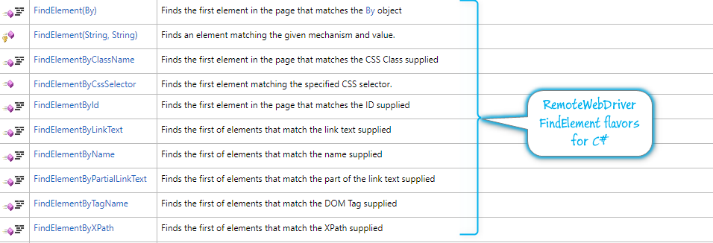
Selenium - FindElements
To look for an object in your automation script, the Selenium driver supports different flavors of the FindElement method (see below)
For most of our purposes we will use the FindElementByXPath() method.

Slide 16
Thank You

